Slide 1
Passerelles numériques
A Gateway for Life
05-Class and Object

Slide 2
Outline
Class & Object
Property & Method
Constructor
this
Public & Private
Setter() & getter() method

Slide 3
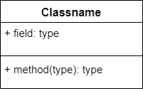
Class
Class is a template or blueprint which defines the
State (instance variable ,field ,property) and
Behaviour(method)
for object(s)
Syntax:
class ClassName{
//instance variable(s)
//method(s)
}

Slide 4
Object
An object represents a real-world entity.
In real life, each object has:
Characteristics – attributes, properties, or features describing the object.
Actions – activities or operations performed by the object.
An object is an instance of class
Syntax:
ClassName objectName = new ClassName();

Slide 5

Example
Class: Dog
Characteristics – name, breed, color, and age
Actions – bark, eat, and run
Object: myDog
Characteristics:
name: Ahkiki
breed: bulldog
color: white
age: 1
Actions:
bark: “WoahWoah”
eat: doughnut
run: use 4 legs

Slide 6
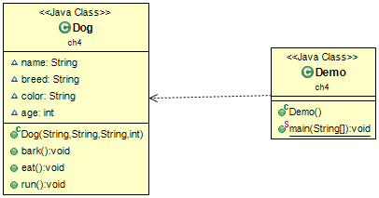
Create class and object
UML diagram

Slide 7
Create Dog class
public class Dog {
String name;
String breed;
String color;
int age;
public Dog(String name,String breed,String color,int age) {
this.name=name;
this.breed=breed;
this.color=color;
this.age=age;
}
public void bark() {
System.out.println("WoahWoah");
}
public void eat() {
System.out.println("Doughnut is my favorite food");
}
public void run() {
System.out.println("We run with 4 legs");
}
}
Properties
Constructor
Methods
Notes:
Talk about this keyword

Slide 8
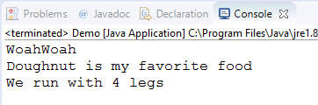
Create myDog object
public class Demo {
public static void main(String[] args) {
// create myDog object
Dog myDog = new Dog("Ahkiki", "BullDog", "White", 1);
// calling the method of class Dog
myDog.bark();
myDog.eat();
myDog.run();
}
}

Slide 9
Activity#1
Suppose we want to model Student as a class. What are the properties and actions or methods could you think of?
properties: name, age, gender, batch, scores
methods: review lesson, calculate average score
5mn

Slide 10
Activity#2
Create Student class and make 3 student objects from this class with the following data:
student1 name: "Makara", age:20, gender: 'F', batch: "SNA2019"
student name: "Dara", age:21, gender: ‘F’ , batch: "WEP2019"
student3 name: "Vebol", age: 22, gender: 'M', batch: "WEP2019"
reviewLesson(): output “Requires to review lesson before going to class”
20mn

Slide 11
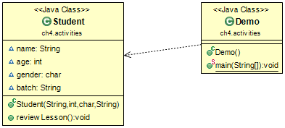
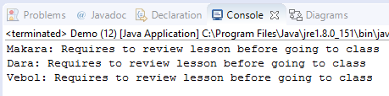
Activity#2
student1 name: "Makara", age:20, gender: 'F', batch: "SNA2019"
student2 name: "Dara", age:21, gender: ‘F’ , batch: "WEP2019"
student3 name: "Vebol", age: 22, gender: 'M', batch: "WEP2019“
reviewLesson(): output “Requires to review lesson before
going to class”

Slide 12
Constructor
Constructor is a special method of a class that has the same name as the class name
A constructor is used to initialize the properties of a class
A constructor can be overloaded with different types and number of parameters
When the object is instantiated, the compiler invokes the constructor based on the number, type, and sequence of arguments passed to it

Slide 13
Class Dog
public class Dog {
String name;
String breed;
String color;
int age;
//constructor with 1 parameter for name
public Dog(String n) {
name = n;
}
//constructor with 4 parameters for name, breed, color and age
public Dog(String name,String breed,String color,int age) {
this.name=name;
this.breed=breed;
this.color=color;
this.age=age;
}
public void bark() {
System.out.println(this.name+ " barks WoahWoah");
}
public void eat() {
System.out.println("Doughnut is my favorite food");
}
public void run() {
System.out.println("We run with 4 legs");
}
}

Slide 14
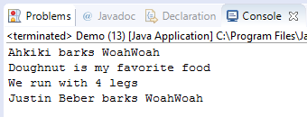
Class Demo
public class Demo {
public static void main(String[] args) {
// create myDog object
Dog myDog = new Dog("Ahkiki", "BullDog", "White", 1);
// calling the method of class Dog
myDog.bark();
myDog.eat();
myDog.run();
//create lulu dog object with different constructor
Dog lulu = new Dog("Justin Beber");
lulu.bark();
}
}
Notes:
Open debug and show them the process of calling to different constructor

Slide 15
Default constructor
If no constructor defined in the class we could call default constructor to instantiate the object

Slide 16
Class Dog
public class Dog {
String name;
String breed;
String color;
int age;
public void bark() {
System.out.println(this.name+ " barks WoahWoah");
}
public void eat() {
System.out.println("Doughnut is my favorite food");
}
public void run() {
System.out.println("We run with 4 legs");
}
}

Slide 17
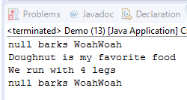
Class Demo
public class Demo {
public static void main(String[] args) {
// create myDog object with default constructor
Dog myDog = new Dog();
// calling the method of class Dog
myDog.bark();
myDog.eat();
myDog.run();
//create lulu dog object with default constructor
Dog lulu = new Dog();
lulu.bark();
}
}
Notes:
How to assign values to name or other properties of the class

Slide 18
How to assign value to other properties of the class?
Set value directly if it’s public
Use setter method if it’s private

Slide 19
Set value directly if it’s public
public class Dog {
//public properties
public String name;
public String breed;
public String color;
int age;
public void bark() {
System.out.println(this.name+ " barks WoahWoah");
}
public void eat() {
System.out.println("Doughnut is my favorite food");
}
public void run() {
System.out.println("We run with 4 legs");
}
}
Notes:
How about age? When there is no access modifier it is default which means similar to public in this case. We could get access it directly

Slide 20
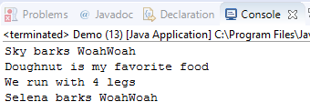
Set value directly if it’s public
public class Demo {
public static void main(String[] args) {
// create myDog object
Dog myDog = new Dog();
//set value "Sky" to name property
myDog.name = "Sky";
// calling the method of class Dog
myDog.bark();
myDog.eat();
myDog.run();
//create lulu dog object with different constructor
Dog lulu = new Dog();
//set value "Selena" to name property
lulu.name="Selena";
lulu.bark();
}
}

Slide 21
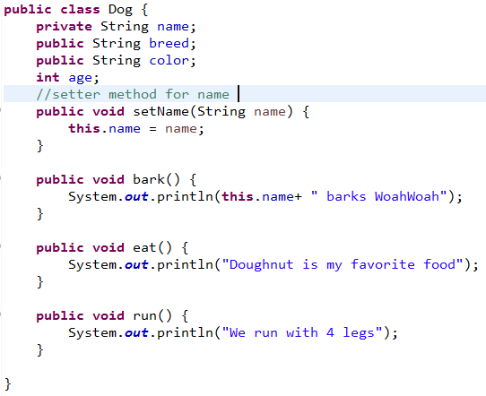
Use setter method if it’s private

Slide 22
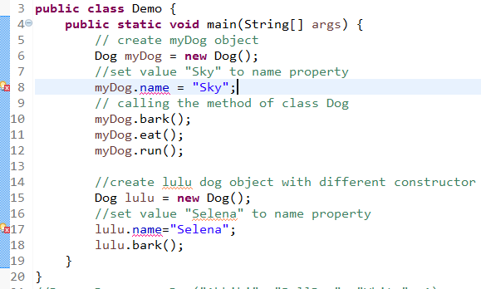
Use setter method if it’s private

Slide 23
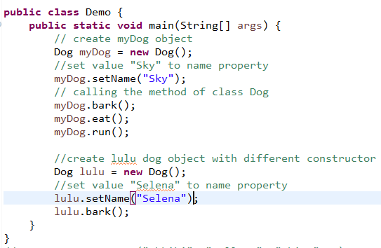
Use setter method if it’s private

Slide 24
getter() method
public class Dog {
private String name;
public String breed;
private String color;
int age;
//getter method of color property
public String getColor() {
return color;
}
//setter method for color property
public void setColor(String color) {
this.color = color;
}
//setter method for name
public void setName(String name) {
this.name = name;
}
public String getName() {
return name;
}
public void bark() {
System.out.println(this.name+ " barks WoahWoah");
}
public void eat() {
System.out.println("Doughnut is my favorite food");
}
public void run() {
System.out.println("We run with 4 legs");
}
}

Slide 25
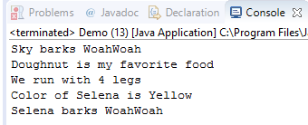
getter() method
public class Demo {
public static void main(String[] args) {
// create myDog object
Dog myDog = new Dog();
//set value "Sky" to name property
myDog.setName("Sky");
// calling the method of class Dog
myDog.bark();
myDog.eat();
myDog.run();
//create lulu dog object with different constructor
Dog lulu = new Dog();
//set value "Selena" to name property
lulu.setName("Selena");
lulu.setColor("Yellow");
System.out.println("Color of "+lulu.getName()+" is "+lulu.getColor());
lulu.bark();
}
}
Notes:
Override toString()

Slide 26
Activity#3
Alter your Student class:
Create default constructor
Create two constructors with different parameters
Create setter and getter method for age and batch
Create Demo class to create student object to test your class
30mn

Slide 27
Constructor
public & private
Class & Object
set and get methods
this

Slide 28
Q&A

